Slide 1
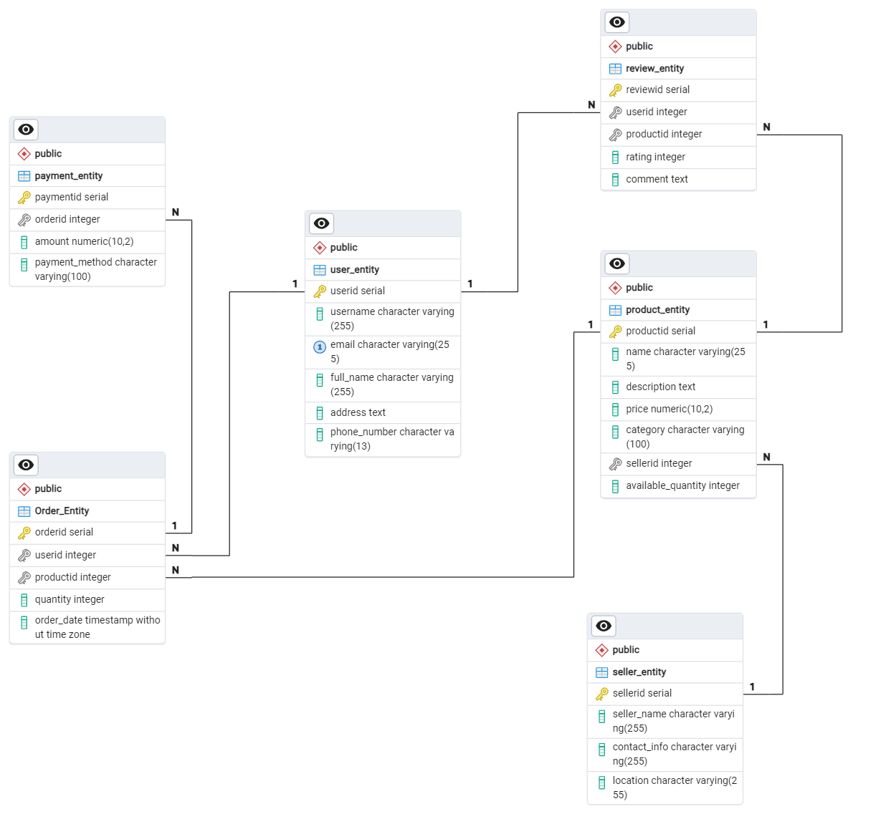
Schema Design for E-commerce Platform

Slide 2
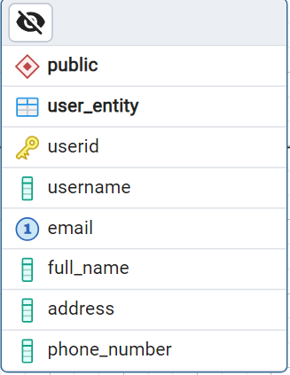





USER ENTITY
First, let's talk about the User entity. This entity stores information about the users of the platform.
It includes attributes like UserID, which is a unique identifier for each user,
Username, the chosen username for the user's account,
Email, the user's email address for account-related communication,
Full_Name, the user's full name as provided during registration, and
Address, the user's shipping address for product delivery,
Phone number for the order related communication

Slide 3
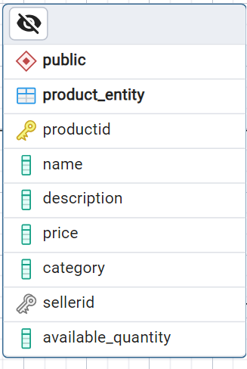





PRODUCT ENTITY
we have the Product entity. This entity holds information about the products available on the platform.
It includes attributes like ProductID, a unique identifier for each product,
Product Name the name of the product,
Product Description a brief description of the product's features and specifications,
Price, the price of the product,
Category, the category to which the product belongs, and
SellerID, a reference to the seller of the product
Available QTY – the Available product quantity

Slide 4
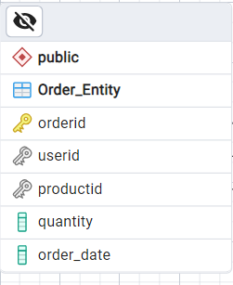


ORDER ENTITY
This entity captures details about the orders placed by users.
It includes attributes like OrderID, a unique identifier for each order,
UserID, a reference to the user who placed the order,
ProductID, a reference to the product included in the order,
Quantity, the quantity of the product ordered, and
Order_Date, the date and time when the order was placed."

Slide 5
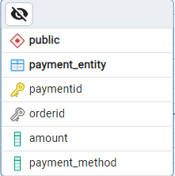





PAYMENT ENTITY
This entity records information about the payment transactions.
It includes attributes like PaymentID, a unique identifier for each payment transaction,
OrderID, a reference to the order for which the payment was made,
Amount, the total amount paid for the order, and
Payment_Method, the method used for payment"

Slide 6
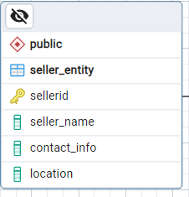

SELLER ENTITY
This entity stores information about the sellers or brands on the platform.
It includes attributes like SellerID, a unique identifier for each seller,
Seller_Name, the name of the seller or brand,
Contact_Info, contact information for the seller, and
Location, the geographical location of the seller."

Slide 7
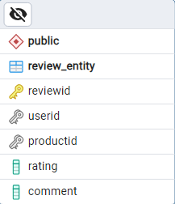




REVIEW ENTITY
This entity holds information about the reviews posted by users.
It includes attributes like ReviewID, a unique identifier for each review,
UserID, a reference to the user who posted the review,
ProductID, a reference to the product being reviewed,
Rating, the rating given by the user for the product, and
Comment, the user's comments or feedback about the product

Slide 8
RELATIONSHIPS
discuss how these entities are connected to each other, forming the backbone of our e-commerce database
**User and Order**: The 'UserID' in the Order entity is a foreign key that references the 'UserID' in the User entity. This relationship indicates which user placed each order.
**Order and Product**: The 'ProductID' in the Order entity is a foreign key that references the 'ProductID' in the Product entity. This relationship shows which product is included in each order.
**Order and Payment**: The 'OrderID' in the Payment entity is a foreign key that references the 'OrderID' in the Order entity. This relationship links each payment transaction to its corresponding order.
**Product and Seller**: The 'SellerID' in the Product entity is a foreign key that references the 'SellerID' in the Seller entity. This relationship identifies the seller of each product.
**User and Review**: The 'UserID' in the Review entity is a foreign key that references the 'UserID' in the User entity. This relationship shows which user posted each review.
**Product and Review**: The 'ProductID' in the Review entity is a foreign key that references the 'ProductID' in the Product entity. This relationship links each review to the product it pertains to.
These relationships allow us to track and manage the flow of data across different aspects of the e-commerce platform, from user registration to order placement and product reviews."

Slide 9



